Slide 1
My assignment presentation
Name : Gefy Aqiilah Aqshal
Class : Fullstack Website -5

Slide 2
Task #1
2

Slide 3
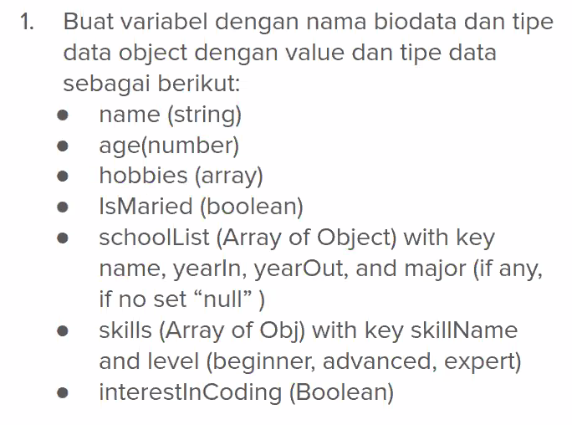
Task #1
3

Slide 4
Task #2
4

Slide 5
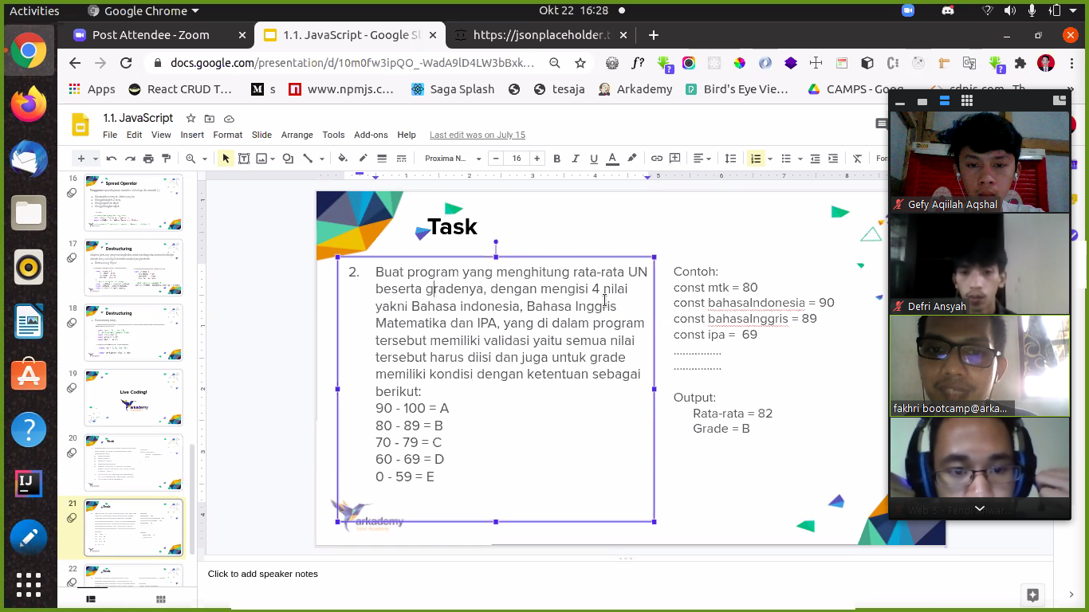
Task #2
80
+ 90
+ 89
+ 69
= 328
328
/ 4
= 82
5

Slide 6
Task #3
6

Slide 7
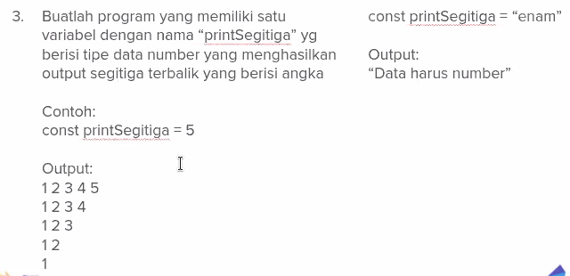
Task #3
1 2 3 4 5
1
1 2 3 4 5
1 2 3 4
1 2 3
1 2
1
2
3
4
5
7

Slide 8
Task #3
#1
1
2
3
4
5
const printSegitiga = 5
let container = ''
if (typeof printSegitiga === 'number') {
for (let i = printSegitiga; i >= 1; i--) {
for (let j = 1; j <= i; j++) {
container += `${j} `
}
container += '\n'
}
} else {
container += 'Data harus number'
}
console.log(container)
1
2
3
4
#2
#3
1
2
3
#4
1
2
#5
1
9

Slide 9
Task #4
9

Slide 10
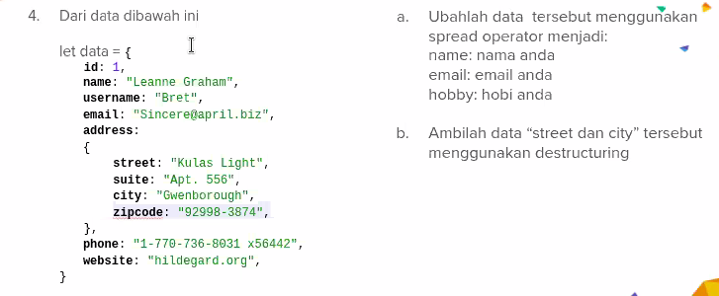
Task #4
10

Slide 11
SEKIAN DAN TERIMAKASIH

